Slide 1
Startup Investment Analysis using Shark Tank India Dataset
Submitted By:
LAKSHAY SHARMA

Slide 2
ABSTRACT
This project analyzes startup investment trends using the Shark Tank India dataset. The analysis focuses on industry-wise funding, founder success patterns, shark investment behavior, and business growth trends using Python and Tableau. Various visualizations and dashboards were created to understand investor preferences and startup performance.

Slide 3
OBJECTIVES
Analyze startup investment trends
Identify highly funded industries
Compare shark investment behavior
Study founder success patterns
Visualize startup funding trends

Slide 4
— TOOLS USED
Tool | Purpose
Python | Data cleaning and analysis
Pandas | Data manipulation
Matplotlib | Data visualization
Tableau | Interactive dashboard
VS Code | Python development

Slide 5
DATASET DESCRIPTION
The dataset contains startup pitch information from Shark Tank India including:
Startup name
Industry
Founder details
Investment amount
Shark investments
Revenue
Deal valuation
Accepted offers
Dataset Size:
Rows: 789
Columns: 80

Slide 6
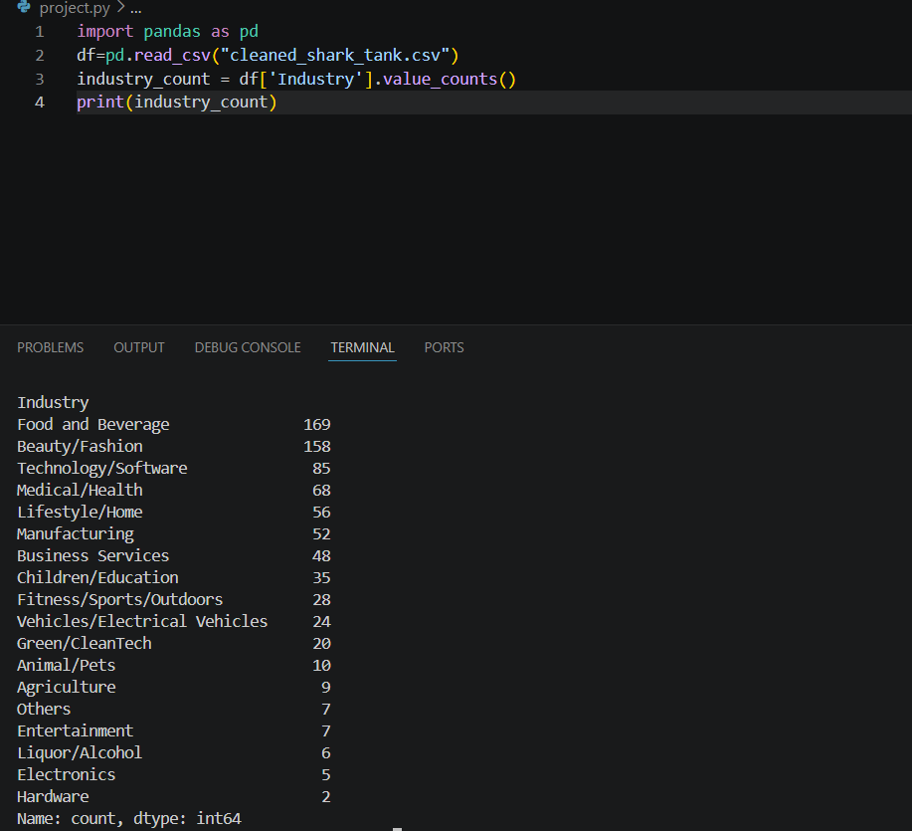
DATA CLEANING
Loading dataset:

Slide 7
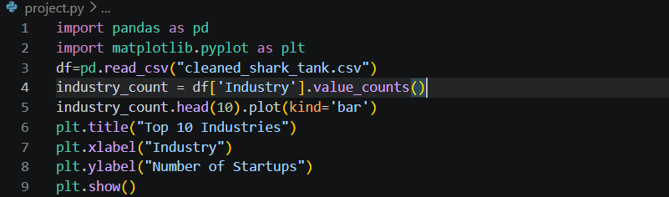
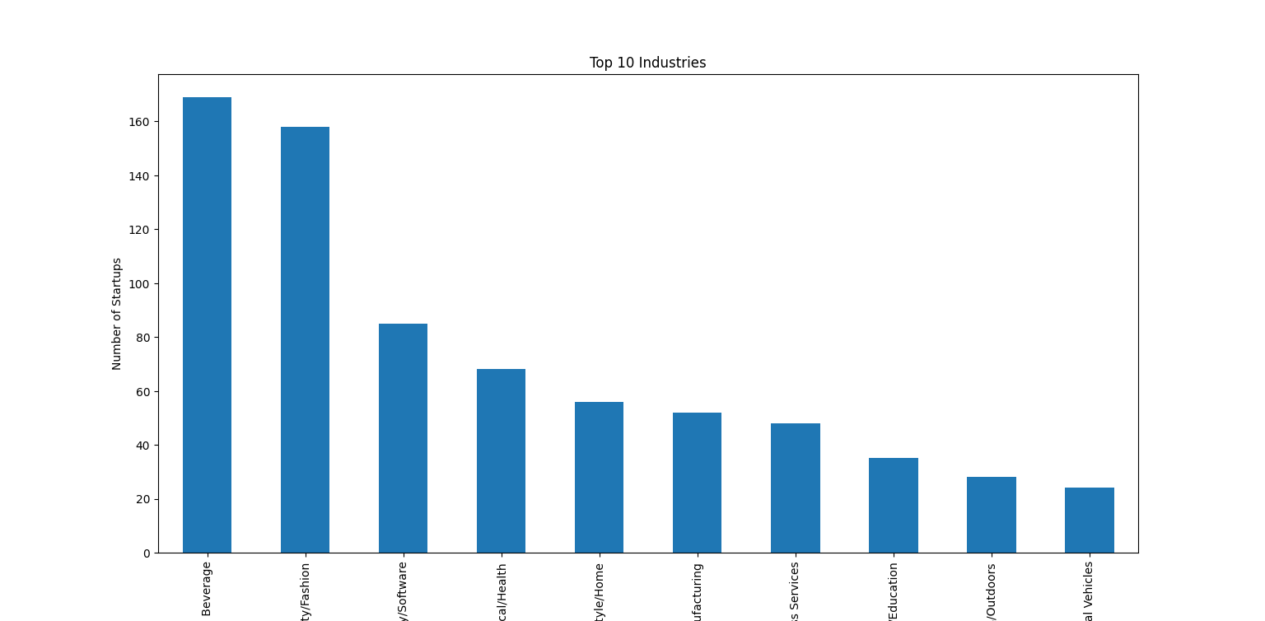

Slide 8
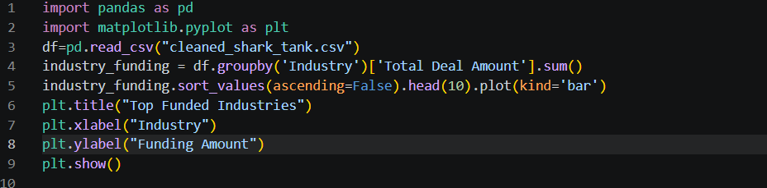
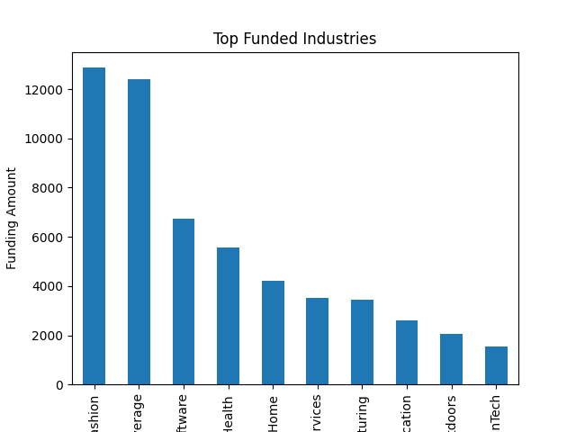
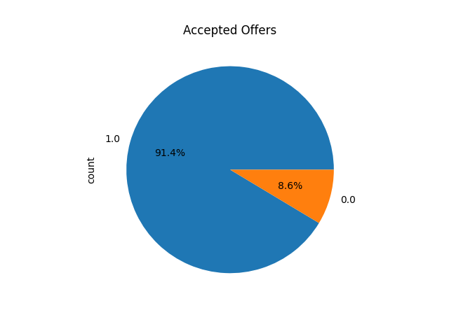

Slide 9
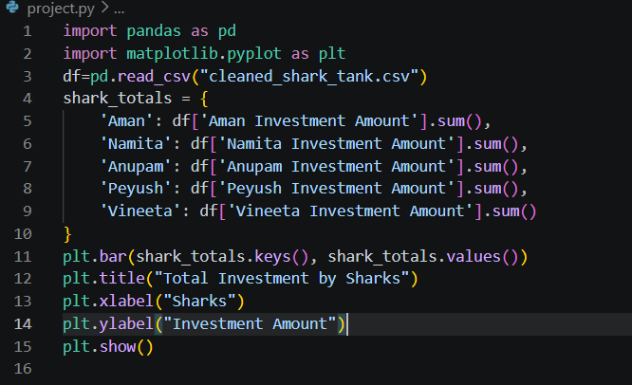
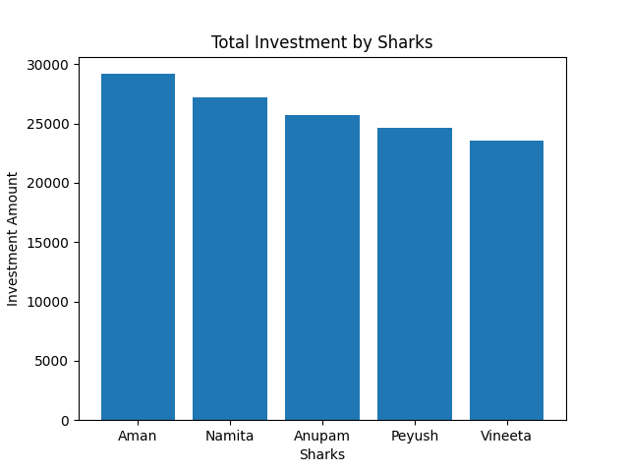

Slide 10
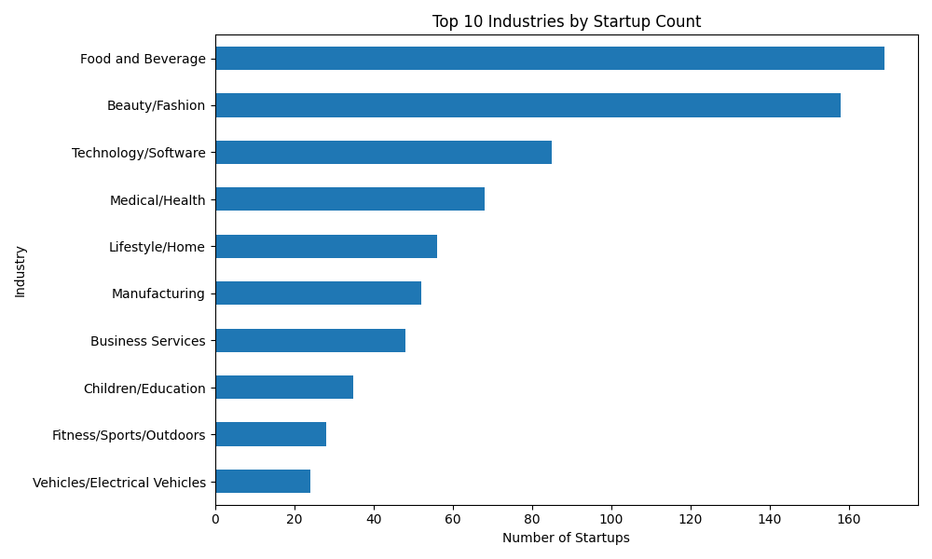

Slide 11
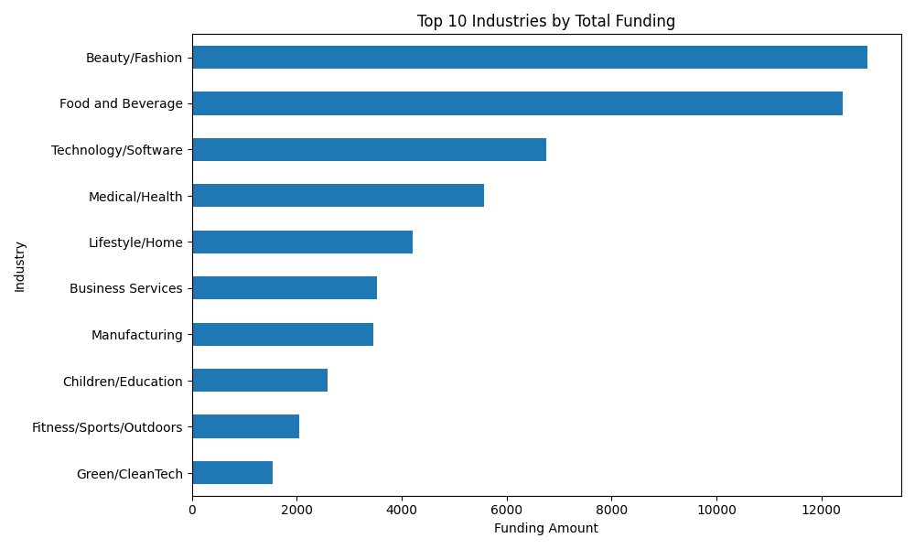

Slide 12
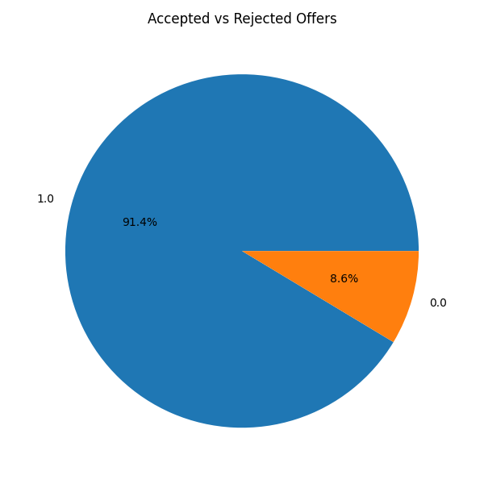

Slide 13
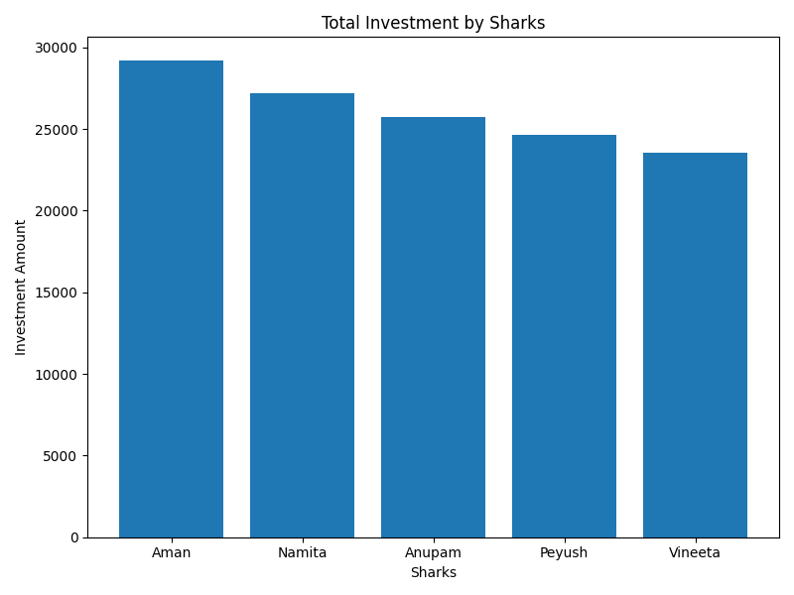

Slide 14
KEY FINDINGS
Food industry dominated startup participation.
Consumer-focused businesses received higher investments.
Shark investors preferred scalable startups.
Revenue performance influenced funding decisions.
Multiple shark collaborations were common.

Slide 15
CONCLUSION
The project successfully analyzed startup investment trends using Shark Tank India data. Data analysis and visualization helped identify investor preferences, funding patterns, and industry growth opportunities. Tableau dashboards provided clear business insights through interactive visualizations.

Slide 16
REFERENCES
Kaggle Dataset
Python Documentation
Tableau Documentation
Pandas Documentation

Slide 17
Thank you

